Slide 1
potential
services
child
classified
prostituted
researchers
cases
Human
Trafficking
labor
research
posts
girls
commercial
technology
methods
activity
sexual
technology
terms
sites
traffickers
Backpage.com
used
trends
Buyers
Jennifer Rapp
Deputy Director, Anti-Human Trafficking Unit
Public Information Officer
Kansas Attorney General Derek Schmidt
providers
Craigslist
study
Demand
women

Slide 2

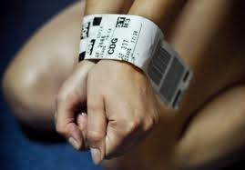
Human Trafficking is based on recruiting, harboring and/or transporting people solely for the purpose of exploitation
No freedom to leave situation
Includes labor trafficking and sex trafficking
Human Trafficking, a modern form of slavery, is one of the fastest growing criminal industry in the world
Exploits a person’s vulnerabilities
Trafficking industry thrives on ignorance and preys upon the uneducated.
Notes:
Dorthy

Slide 3

Human Trafficking in Kansas
More than 83% of human trafficking involves domestic victims and the majority of these are children. This means that most trafficking in Kansas involves local children.
Kansas has adopted new laws that seek to protect and rescue human trafficking victims.

Slide 4
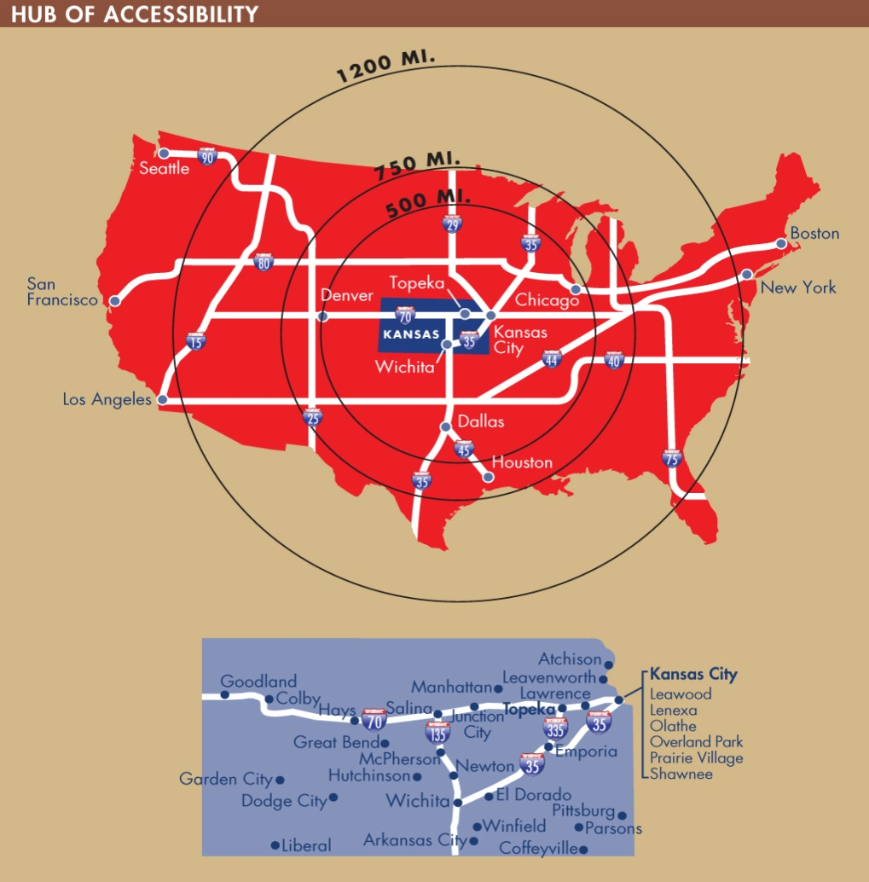
Why Kansas?
Centrally located
Intersection of major federal interstates: I-70 and I-35
Hub of mid-western commerce
Exchange points

Slide 5
Characteristics of a
Sex-Trafficking Victim
  Average age of entry is 12 – 14 years old
  Majority are runaway and/or youth within the foster care system & child protective services: some come from middle class, or wealth and prosperity
  70-90% of sexually exploited children have a history of child sexual abuse
  Most are female
  Not likely to consider themselves as victims
Notes:
Jeff

Slide 6
Sex Trafficking
Who is Vulnerable?
Chronic runaways.
Children suffering serious abuse in their own homes
Foster children who have been sexually exploited.
The throwaway children – those runaways in Kansas who are not reported.
The throwaway children who “age out” of the system.
Missing and homeless children
The 6% of all girls in Kansas: those with a developmental disability.
Sources: National Human Trafficking Resource Center, 2014; Kansas Law Enforcement Information, www.kslawenforcementinfo.com; Colloton interviews: EMCU, Wichita Police; Vice Unit, Overland Park Police; Human Trafficking Advisory Board Members 2014.
Notes:
Dorthy

Slide 7
Risk Factors
Isolation
Emotional Distress
Substance Abuse
Poverty
Family Dysfunction
Homelessness
Developmental Delay
Learning Disabilities
Lack of Social Support
Childhood Sexual Abuse
Mental Illness
Lack of Personal Safety

Slide 8
Obstacles to Identification
Almost never self-identify as trafficking victims
View trafficker as “boyfriend”/trauma bonding
Fear of retaliation/acting on threats
Lured into false sense of “choice”
May have been given new name, branded
Conditioned to view others as “family”
Fearful of law enforcement
Street smart and difficult to interview
Source: National Human Trafficking Resource Center

Slide 9
  Services Critical for Protection
    Medical needs
    Safety Planning
    Treatment for Major Trauma, Complex PTSD
    Long term counseling and assistance
    Housing
    Assistance dealing with and testifying against pimps/traffickers
    Addiction treatment
    Educational needs
    Employment assistance
    Specific Assistance
Notes:
Dorthy

Slide 10

Truckers Against Trafficking
www.truckersagainsttrafficking.org
National group the educates, equips, empowers and mobilizes members of the trucking and travel plaza industry to combat domestic sex trafficking.
KS AG office partnering with TAT and the KMCA.

Slide 11

TAT video

Slide 12
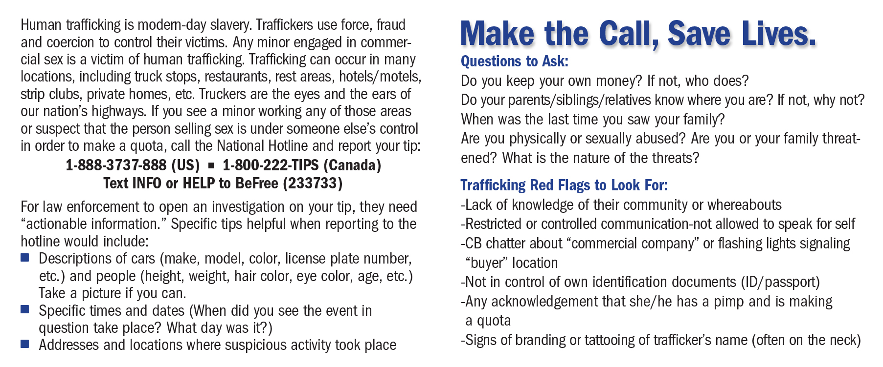
TAT wallet card

Slide 13

TAT wallet card

Slide 14
Change in Kansas Law
The law recognizes the victimization of minors who are commercially exploited in selling sexual relations –even when they don’t believe they are victims.(2013)
In 2015, new law was passed allowing victims of human trafficking to seek civil remedies and restitution from convicted traffickers.
Notes:
Pat

Slide 15

Billboard Campaign

Slide 16
Report Human Trafficking
911(local law enforcement)
Polaris Project National Hotline: 1-888-3737-888 or TEXT INFO or HELP to 233-733 (24 hours, 7 days a week)
To report a sexually exploited or abused minor, call the National Center for Exploited and Missing Children (NCMEC) hotline 1-800-THE-LOST or cyber tip reporting http://www.cybertipline.org .
KSAG Anti-Human Trafficking Unit: 1-800-828-9745

Slide 17

Questions?
Kansas Attorney General, Anti-Human Trafficking Unit
1-800-828-9745

